Slide 1
Open Source IaaS OpenStack
Portions of this PPT draw from PPT authored by Professor Dijiang Huang at
Arizona State University

Slide 2
Open source IaaS options
OpenStack
OpenNebula
Eucalytpus
CloudStack
 | OpenStack | CloudStack | Eucalyptus | OpenNebula
Source Code | Fully open-source, Apache v2.0 | Fully open-source, Apache v2.0 | Fully open-source, GPL v3.0 | Fully open-source, Apache v2.0

Slide 3
Open source IaaS - OpenStack
In July 2010 Rackspace Hosting and NASA jointly launched an open-source cloud-software initiative known as OpenStack.
The community's first official release, code-named Austin, appeared four months later.
In 2011 developers of the Ubuntu Linux distribution decided to adopt OpenStack.
In 2012 Red Hat announced a preview of their OpenStack distribution.
The project is managed by the OpenStack Foundation, a non-profit corporate entity established in September 2012 to promote OpenStack software and its community.
More than 200 companies joined the project among which are AMD, Brocade Communications Systems, Canonical, Cisco, Dell, EMC, Ericsson, Groupe Bull, HP, IBM, Inktank, Intel, NEC, Rackspace Hosting, Red Hat, SUSE Linux, VMware, and Yahoo!.
Written in: Python

Slide 4
Open source IaaS - OpenNebula
OpenNebula is an open-source cloud computing toolkit for managing heterogeneous distributed data center infrastructures.
The OpenNebula toolkit manages a data center's virtual infrastructure to build private, public and hybrid implementations of infrastructure as a service.
OpenNebula is sponsored by C12G.
Developer(s): OpenNebula Community
Written in: C++, C, Ruby, Java, Shell script, lex, yacc
Operating system: Linux

Slide 5
Open source IaaS - Eucalytpus
Eucalyptus is open source computer software for building Amazon Web Services (AWS)-compatible private and hybrid cloud computing environments marketed by the company Eucalyptus Systems.
Eucalyptus enables pooling compute, storage, and network resources that can be dynamically scaled up or down as application workloads change.
Eucalyptus Systems announced a formal agreement with AWS in March 2012 to maintain compatibility.
Developer(s): Eucalyptus Systems, Inc.
Written in: Java, C
Operating system: GNU/Linux, can host Linux and Windows VMs

Slide 6
Open source IaaS - CloudStack
In May 2010, Cloud.com released most of CloudStack as free software under the GNU General Public License, version 3 (GPLv3).
Cloud.com and Citrix both supported OpenStack at its announcement in July 2010.
Citrix purchased Cloud.com on July 12, 2011.
In August 2011, Citrix released the remaining code under GPLv3.
In April 2012, Citrix donated CloudStack to the Apache Software Foundation (ASF), where it was accepted into the Apache Incubator; Citrix changed the license to the Apache License version 2. As part of this change, Citrix also ceased their involvement in OpenStack.
On March 20, 2013, CloudStack graduated from Apache Incubator and became a Top-Level Project (TLP) of ASF.
Original author(s): Cloud.com, Citrix
Developer(s): Apache Software Foundation
Written in: Java (primarily)

Slide 7
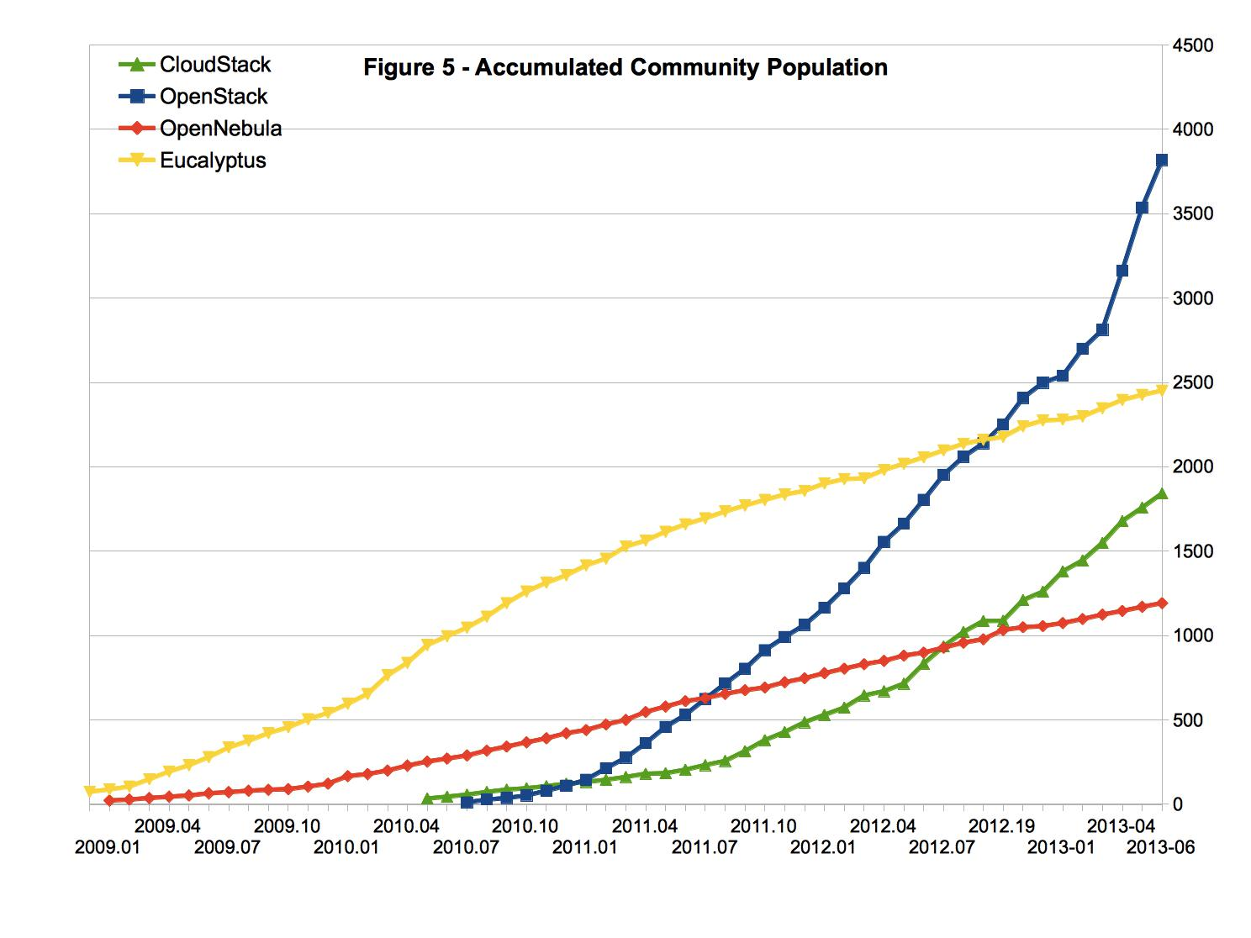
Open source IaaS community analysis

Slide 8
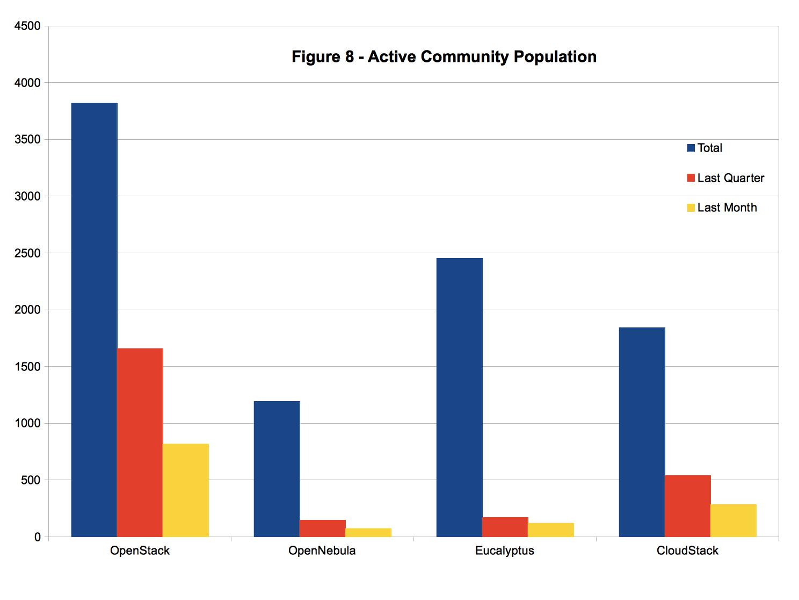
Open source IaaS community analysis
2013 Apr.-Jun.
2013 Jun.

Slide 9
Open source IaaS openness evaluation
The Perspective of the Developer
 | OpenStack | CloudStack | Eucalyptus | OpenNebula
Development Model | Public development | Public development | Public development | Public development
Developer Engagement | Contributor license agreement | Contributor license agreement | Contributor license agreement | Contributor license agreement
Governance Model | Foundation | Technical expert | Benevolent dictator | Benevolent dictator
The Perspective of the User
 | OpenStack | CloudStack | Eucalyptus | OpenNebula
API Ecosystem | OpenStack API | Amazon API | Amazon API | Amazon API
Production Readiness | No, only available through any of the several vendor specific “stacks” | Enterprise-ready and direct support from developers | Enterprise-ready and direct support from developers | Enterprise-ready and direct support from developers

Slide 10
OpenStack
Open source IaaS

Slide 11
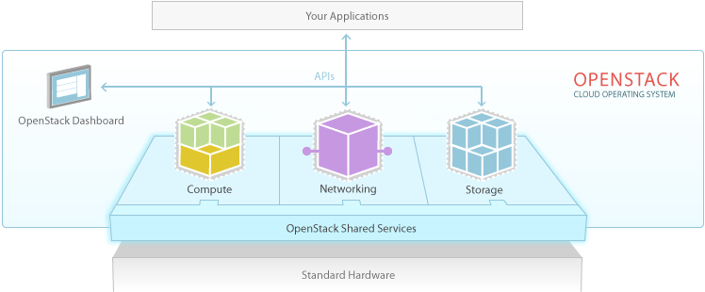
OpenStack Software
OpenStack is a cloud operating system that controls large pools of compute, storage, and networking resources throughout a datacenter, all managed through a dashboard that gives administrators control while empowering their users to provision resources through a web interface.

Slide 12
OpenStack releases
Series | Status | Releases
Juno | underdevelopment | Due Oct 16, 2014
Icehouse | Current stable release | 2014.1
Havana | Security-supported | 2013.2
Grizzly | Current stable release, security-supported | 2013.1
Folsom | Security-supported | 2012.2
Essex | EOL | 2012.1
Diablo | EOL | 2011.3
Cactus | Deprecated | 2011.2
Bexar | Deprecated | 2011.1
Austin | Deprecated | 2010.1

Slide 13
OpenStack Components
There are currently seven core components of OpenStack:
Compute
Object Storage
Identity
Dashboard
Block Storage
Network
Image Service

Slide 14
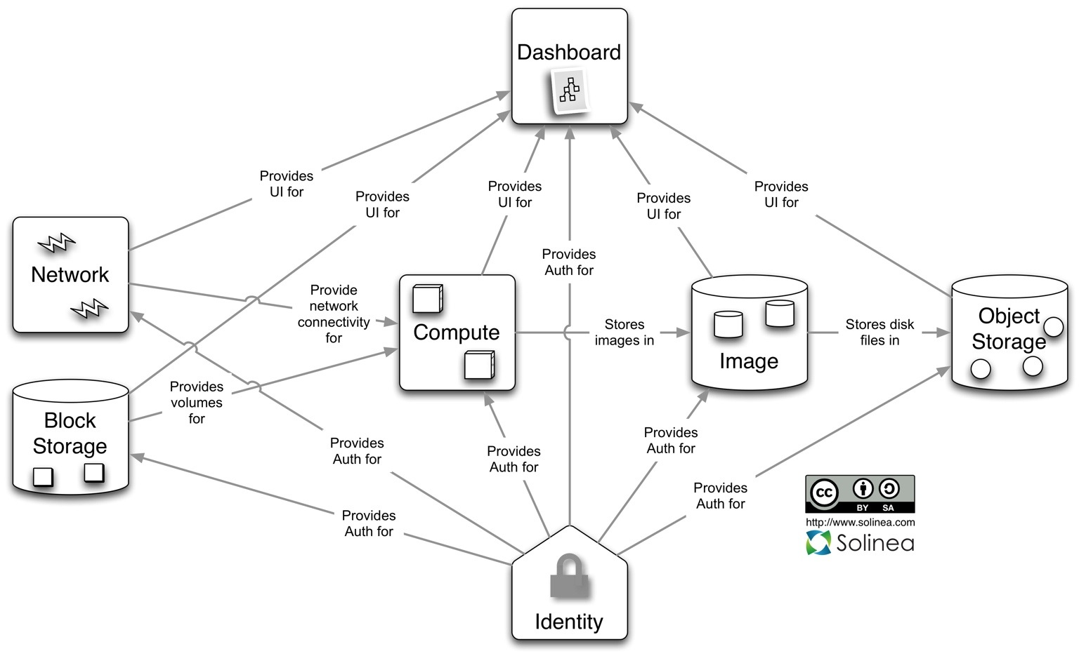
Conceptual Architecture

Slide 15

OpenStack Components - Swift
Object Store (codenamed “Swift“) allows you to store or retrieve files (but not mount directories like a fileserver).

Slide 16
OpenStack Components - Cinder
Block Storage (codenamed “Cinder“) provides persistent block storage to guest VMs.
This project was born from code originally in Nova (the nova-volume service that has been deprecated).
While this was originally a block storage only service, it has been extended to NFS shares.
Now is Ceph

Slide 17
OpenStack Components - Glance
Image Store (codenamed “Glance“) provides a catalog and repository for virtual disk images.
These disk images are mostly commonly used in OpenStack Compute.
Image Store can store the actual virtual disk files in the Object Store.

Slide 18
OpenStack Components - Nova
Compute (codenamed “Nova“) provides virtual servers upon demand.
Compute stores and retrieves virtual disks (“images”) and associated metadata in the Image Store (“Glance”).

Slide 19
OpenStack Components - Horizon
Dashboard (codenamed “Horizon“) provides a modular web-based user interface for all the OpenStack services.
With this web GUI, you can perform most operations on your cloud like launching an instance, assigning IP addresses and setting access controls.

Slide 20
OpenStack Components - Keystone
Identity (codenamed “Keystone“) provides authentication and authorization for all the OpenStack services.
It also provides a service catalog of services within a particular OpenStack cloud.

Slide 21
OpenStack Components - Quantum
Network (which used to named “Neutron” but is in the process of being renamed due to a trademark issue) provides “network connectivity as a service” between interface devices managed by other OpenStack services (most likely Nova).
The service works by allowing users to create their own networks and then attach interfaces to them.
Neutron has a pluggable architecture to support many popular networking vendors and technologies.

Slide 22
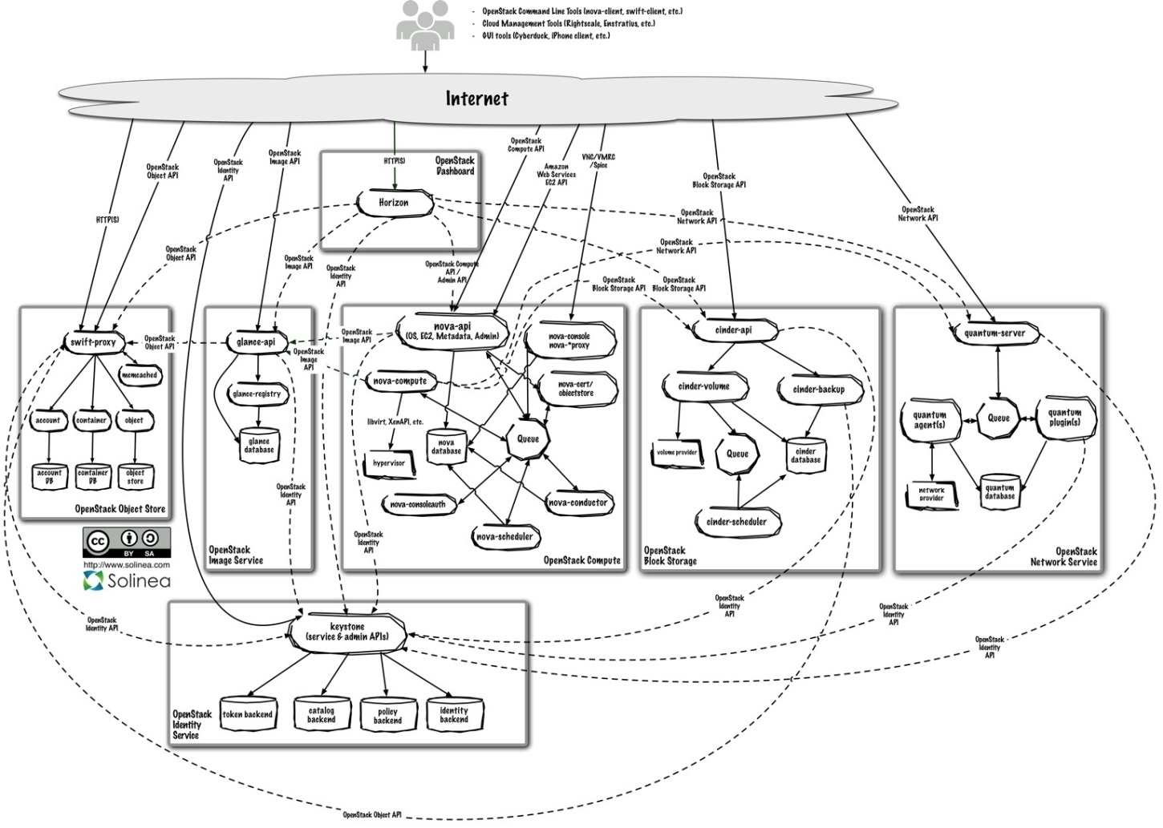
Logical Architecture

Slide 23
Dashboard
Horizon is a modular Django web application that provides an end user and cloud operator interface to OpenStack services.
The interface has user screens for:
Quota and usage information
Instances to operate cloud virtual machines
Volume management to control creation, deletion and connectivity to block storage
Image and snapshot to upload and control virtual images, which are used to backup and boot new instances
Access and security to manage key pairs and security groups (firewall rules)
In addition to the user screens, it also provides an interface for cloud operators. The operator interface sees across the entire cloud and adds some configuration focused screens such as:
Flavors to define service catalog offerings of CPU, memory and boot disk storage
Projects to provide logical groups of user accounts
Users to administer user accounts
System Info to view services running in the cloud and quotas applied to projects

Slide 24
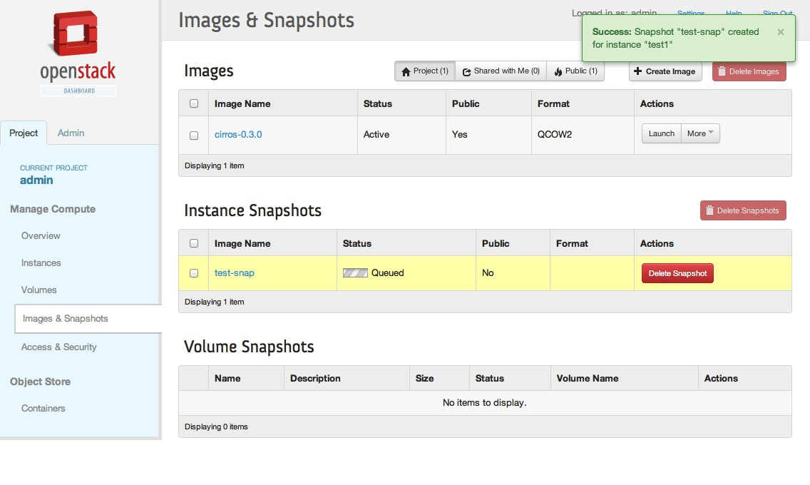
Dashboard - demo

Slide 25
Compute
Nova is the most complicated and distributed component of OpenStack.
Below is a list of these processes:
nova-api
nova-compute
nova-scheduler
nova-conductor
nova-console
Other involved components:
queue
SQL database

Slide 26
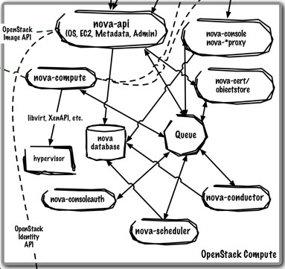
Compute - nova-api
nova-api is a family of daemons (nova-api, nova-api-os-compute, nova-api-ec2, nova-api-metadata or nova-api-all) that accept and respond to end user compute API calls.
It supports OpenStack Compute API, Amazon’s EC2 API and a special Admin API (for privileged users to perform administrative actions).
It also initiates most of the orchestration activities (such as running an instance) as well as enforces some policy (mostly quota checks).
Different daemons allow Nova to implement different APIs (Amazon EC2, OpenStack Compute, Metadata) or combination of APIs (nova-api starts both the EC2 and OpenStack APIs).

Slide 27
Compute - nova-compute
The nova-compute process is primarily a worker daemon that creates and terminates virtual machine instances via hypervisor’s APIs (XenAPI for XenServer/XCP, libvirt for KVM or QEMU, VMwareAPI for VMware, etc.).
The process by which it does so is fairly complex but the basics are simple: accept actions from the queue and then perform a series of system commands (like launching a KVM instance) to carry them out while updating state in the database through nova-conductor.

Slide 28
Compute - nova-scheduler
The nova-scheduler process is conceptually the simplest piece of code in OpenStack Nova: take a virtual machine instance request from the queue and determines where it should run (specifically, which compute server host it should run on).
In practice, it is now one of the most complex.

Slide 29
Compute - nova-conductor
A new service called nova-conductor has been added to this release.
It mediates access to the database for other daemons (only nova-compute in this release) to provide greater security.

Slide 30
Compute - nova-console
Nova also provides console services to allow end users to access their virtual instance’s console through a proxy.
This involves several daemons (nova-console, nova-xvpvncproxy, nova-spicehtml5proxy and nova-consoleauth).

Slide 31
Compute - queue and database
The queue provides a central hub for passing messages between daemons. This is usually implemented with RabbitMQ today, but could be any AMPQ message queue (such as Apache Qpid), or Zero MQ.
The SQL database stores most of the build-time and run-time state for a cloud infrastructure. This includes the instance types that are available for use, instances in use, networks available and projects. Theoretically, OpenStack Nova can support any database supported by SQL-Alchemy but the only databases currently being widely used are sqlite3 (only appropriate for test and development work), MySQL and PostgreSQL.

Slide 32
Object Store
OpenStack’s Object Store (“Swift”) is designed to provide large scale storage of data that is accessible via APIs. Unlike a traditional file server, it is completely distributed, storing multiple copies of each object to achieve greater availability and scalability.
It includes the following components:
Proxy server
Account servers
Container servers
Object servers

Slide 33
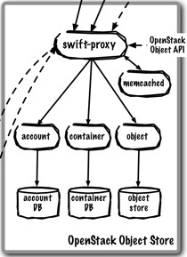
Object Store
Proxy server (swift-proxy-server) accepts incoming requests via the OpenStack Object API or just raw HTTP. It accepts files to upload, modifications to metadata or container creation. In addition, it will also serve files or container listing to web browsers. The proxy server may utilize an optional cache (usually deployed with memcache) to improve performance.
Account servers manage accounts defined with the object storage service.
Container servers manage a mapping of containers (i.e folders) within the object store service.
Object servers manage actual objects (i.e. files) on the storage nodes.

Slide 34
Image Store
OpenStack Image Store centralizes virtual images for users and other cloud services:
Stores public and private images that users can utilize to start instances
Users can query and list available images for use
Delivers images to Nova to start instances
Snapshots from running instances can be stored so that virtual machines can be backed

Slide 35
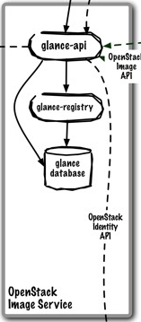
Image Store
glance-api accepts Image API calls for image discovery, image retrieval and image storage.
glance-registry stores, processes and retrieves metadata about images (size, type, etc.).
A database to store the image metadata. Like Nova, you can choose your database depending on your preference (but most people use MySQL or SQlite).
A storage repository for the actual image files. In the diagram above, Swift is shown as the image repository, but this is configurable. In addition to Swift, Glance supports normal filesystems, RADOS block devices, Amazon S3 and HTTP. Be aware that some of these choices are limited to read-only usage.

Slide 36
Identity
Keystone provides a single point of integration for OpenStack policy, catalog, token and authentication:
Authenticate users and issue tokens for access to services
Store users and tenants for a role-based access control (RBAC)
Provides a catalog of the services (and their API endpoints) in the cloud
Create policies across users and services

Slide 37
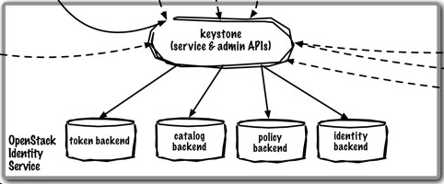
Identity
keystone handles API requests as well as providing configurable catalog, policy, token and identity services.
Each Keystone function has a pluggable backend which allows different ways to use the particular service. Most support standard backends like LDAP or SQL, as well as Key Value Stores (KVS).

Slide 38
Network
Quantum provides “network connectivity as a service” between interface devices managed by other OpenStack services (most likely Nova).
Like many of the OpenStack services, Quantum is highly configurable due to it’s plug-in architecture. These plug-ins accommodate different networking equipment and software. As such, the architecture and deployment can vary dramatically.

Slide 39
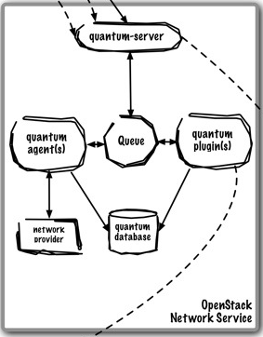
Network
quantum-server accepts API requests and then routes them to the appropriate quantum plugin for action.
Quantum plugins and agents perform the actual work such as plugging and unplugging ports, creating networks or subnets and IP addressing. These plugins and agents differ depending on the vendor and technologies used in the particular cloud. The common agents are L3 (layer 3), DHCP (dynamic host IP addressing) and vendor specific plug-in agent(s).
Most Quantum installations will also make use of a messaging queue to route information between the quantum-server and various agents as well as a database to store networking state for particular plugins.

Slide 40
Block Storage
Cinder separates out the persistent block storage functionality that was previously part of OpenStack Compute (in the form of nova-volume) into it’s own service. The OpenStack Block Storage API allows for manipulation of volumes, volume types (similar to compute flavors) and volume snapshots:
Create, modify and delete volumes
Snapshot or backup volumes
Query volume status and metadata

Slide 41
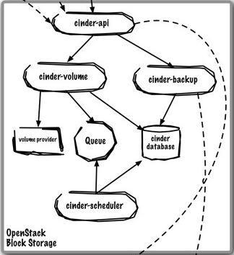
Block Storage
cinder-api accepts API requests and routes them to cinder-volume for action.
cinder-volume acts upon the requests by reading or writing to the Cinder database to maintain state, interacting with other processes (like cinder-scheduler) through a message queue and directly upon block storage providing hardware or software. It can interact with a variety of storage providers through a driver architecture.
Much like nova-scheduler, the cinder-scheduler daemon picks the optimal block storage provider node to create the volume on.
cinder-backup is a new service that backs up the data from a volume (not a full snapshot) to a backend service. Currently, the only shipping backend service is Swift.
Cinder deployments will also make use of a messaging queue to route information between the cinder processes as well as a database to store volume state.

Slide 42
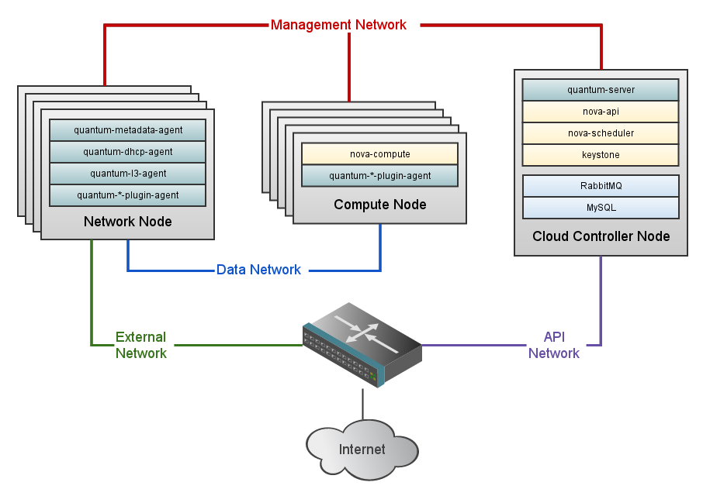
OpenStack deployment

Slide 43
OpenStack deployment
A standard OpenStack Networking setup has up to four distinct physical data center networks:
Management network. Used for internal communication between OpenStack Components. The IP addresses on this network should be reachable only within the data center.
Data network. Used for VM data communication within the cloud deployment. The IP addressing requirements of this network depend on the OpenStack Networking plugin in use.
External network. Used to provide VMs with Internet access in some deployment scenarios. The IP addresses on this network should be reachable by anyone on the Internet.
API network. Exposes all OpenStack APIs, including the OpenStack Networking API, to tenants. The IP addresses on this network should be reachable by anyone on the Internet. This may be the same network as the external network, as it is possible to create a subnet for the external network that uses IP allocation ranges to use only less than the full range of IP addresses in an IP block.

